Slide 1
CST 136 – OOP in C++
Oregon Institute of Technology
Spring 2002
Instructor: Dom Virgilio

Slide 2
Week | Date | Topics | Chapters
1 | 4/1 | Course Intro, C to C++, Intro to OOP, Control Structures, Functions, Arrays, Pointers and Strings | 1, 2, 3, 4, 5
2 | 4/8 | Classes and Data Abstraction, Dynamic Memory, Static, Constructors and Destructors | 6, 7
 | 4/13 | LAB
3 | 4/15 | Inheritance | 9
4 | 4/22 | Templates | 6, 12
 | 4/27 | LAB
5 | 4/29 | Implicit Conversion, References, Review | 3, 5
6 | 5/6 | MIDTERM EXAM
 | 5/11 | LAB
7 | 5/13 | Operator overloading (I), Virtual Functions (I) | 8, 10
8 | 5/20 | Const, Friends, Operator Overloading (II) | 7, 8
 | 5/25 | LAB
9 | *5/27* | Virtual Functions (II), Streams, Type Conversion | 10, 11, 14
10 | 6/3 | Multiple Inheritance, Exceptions, Run-time Type Info | 9, 10, 13, 21
 | 6/8 | LAB
11 | 6/10 | FINAL EXAM

Slide 3
Overview – Week #3
Assignment #1 Review
Inheritance

Slide 4
Exercises – Week #3
OOPBJ
Rush Hour
OOWater
OOLane’s Express
Not So Hardware - Revisited
Muzix

Slide 5
Assignment #1 Review

Slide 6
Inheritance

Slide 7
Inheritance
Inheritance
  New classes created from existing classes
  Absorb attributes and behaviors
  Derived class
    Class that inherits data members and member functions from a previously defined base class
  Single inheritance
    Class inherits from one base class
  Multiple inheritance
    Class inherits from multiple base classes
  Types of inheritance
    public: Derived objects are accessible by the base class objects
    private: Derived objects are inaccessible by the base class
    protected: Derived classes and friends can access protected members of the base class

Slide 8
Inheritance
Polymorphism
  Write programs in a general fashion
  Handle a wide variety of existing (and unspecified) related classes

Slide 9
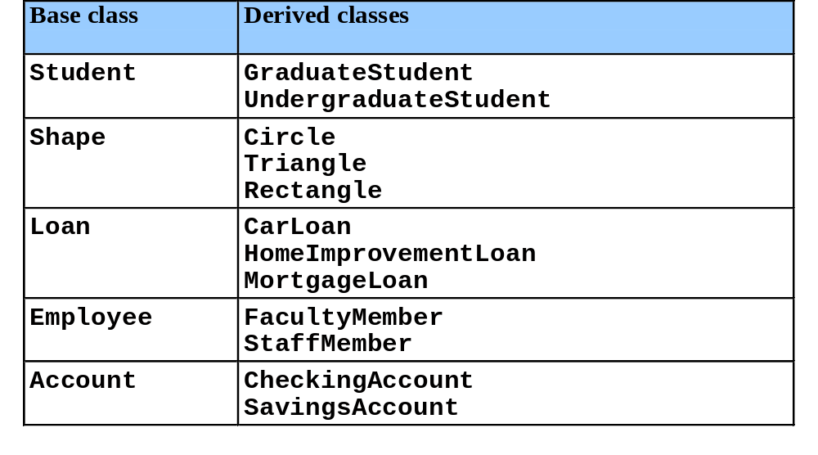
Base and Derived Classes
Base and derived classes
  Often an object from a derived class (subclass) is also an object of a base class (superclass)
    A rectangle is a derived class in reference to a quadrilateral and a base class in reference to a square
Inheritance examples

Slide 10
Exercise #1 – “OOPBJ”
Recall the PB&J exercise from Lecture #1.
What are some possible class hierarchies, including base and derived classes? List some functions and data for each.
Give some examples of how to extend the hierarchy in one direction or another.
What might be a way to include multiple inheritance?

Slide 11
Base and Derived Classes
We should also ask: What makes the classes different?
This is one of the least used strategies by novice object-oriented designers.
Learn to do this test after you do your initial class hierarchy.

Slide 12
Exercise #2 – “Rush Hour”
The Mayor contacts our class and tells us she needs a traffic simulator for the City of Portland. Our OO system needs to model all forms of transportation available to the citizens of Portland.
How might this traffic simulator work?
What sort of data would the Mayor be interested in?
What types of objects might we want to model?
How do the objects differ?
What are some possible class hierarchies, including base and derived classes? List some functions and data for each.
Give some examples of how to extend the hierarchy in one direction or another.
What types of Sorts or Queries might we want to offer?
How might multiple inheritance be used in this system?

Slide 13
-Break-

Slide 14
Base and Derived Classes
Implementation of public inheritance
    class CommissionWorker : public Employee {
    ...
    };
  Class CommissionWorker inherits from class Employee
  friend functions not inherited
  private members of base class not accessible from derived class

Slide 15
protected
protected access
  Intermediate level of protection between public and private inheritance
  Derived-class members can refer to public and protected members of the base class simply by using the member names
  Note that protected data “breaks” encapsulation

Slide 16
Casting
Derived classes relationships to base classes
  Objects of a derived class can be treated as objects of the base class
    Reverse not true — base class objects cannot be derived-class objects
Downcasting a pointer
  Use an explicit cast to convert a base-class pointer to a derived-class pointer
  If pointer is going to be dereferenced, the type of the pointer must match the type of object to which the pointer points
  Format:
  derivedPtr = static_cast< DerivedClass * > basePtr;

Slide 17
Casting
The following example:
  Demonstrates the casting of base class pointers to derived class pointers
  Class Circle is derived from class Point
  A pointer of type Point is used to reference a Circle object, and a pointer to type Circle is used to reference a Point object

Slide 18
1 // Fig. 9.4: point.h
2 // Definition of class Point
3 #ifndef POINT_H
4 #define POINT_H
5
6 #include <iostream>
7
8 using std::ostream;
9
10 class Point {
11 friend ostream &operator<<( ostream &, const Point & );
12 public:
13 Point( int = 0, int = 0 ); // default constructor
14 void setPoint( int, int ); // set coordinates
15 int getX() const { return x; } // get x coordinate
16 int getY() const { return y; } // get y coordinate
17 protected: // accessible by derived classes
18 int x, y; // x and y coordinates of the Point
19 };
20
21 #endif
22 // Fig. 9.4: point.cpp
23 // Member functions for class Point
24 #include <iostream>
25 #include "point.h"
26
27 // Constructor for class Point
28 Point::Point( int a, int b ) { setPoint( a, b ); }
29
30 // Set x and y coordinates of Point
31 void Point::setPoint( int a, int b )
32 {
33 x = a;

Slide 19
34 y = b;
35 }
36
37 // Output Point (with overloaded stream insertion operator)
38 ostream &operator<<( ostream &output, const Point &p )
39 {
40 output << '[' << p.x << ", " << p.y << ']';
41
42 return output; // enables cascaded calls
43 }
44 // Fig. 9.4: circle.h
45 // Definition of class Circle
46 #ifndef CIRCLE_H
47 #define CIRCLE_H
48
49 #include <iostream>
50
51 using std::ostream;
Class Circle publicly inherits from class Point, so it will have class Point's public and protected member functions and data.
52
53 #include <iomanip>
54
55 using std::ios;
56 using std::setiosflags;
57 using std::setprecision;
58
59 #include "point.h"
60
61 class Circle : public Point { // Circle inherits from Point
62 friend ostream &operator<<( ostream &, const Circle & );
63 public:
64 // default constructor

Slide 20
65 Circle( double r = 0.0, int x = 0, int y = 0 );
66
67 void setRadius( double ); // set radius
68 double getRadius() const; // return radius
69 double area() const; // calculate area
70 protected:
71 double radius;
72 };
73
74 #endif
75 // Fig. 9.4: circle.cpp
76 // Member function definitions for class Circle
Circle inherits from Point, and has Point's data members (which are set by calling Point's constructor).
77 #include "circle.h"
78
79 // Constructor for Circle calls constructor for Point
80 // with a member initializer then initializes radius.
81 Circle::Circle( double r, int a, int b )
82 : Point( a, b ) // call base-class constructor
83 { setRadius( r ); }
84
85 // Set radius of Circle
86 void Circle::setRadius( double r )
87 { radius = ( r >= 0 ? r : 0 ); }
88

Slide 21
89 // Get radius of Circle
90 double Circle::getRadius() const { return radius; }
91
92 // Calculate area of Circle
93 double Circle::area() const
94 { return 3.14159 * radius * radius; }
95
96 // Output a Circle in the form:
97 // Center = [x, y]; Radius = #.##
98 ostream &operator<<( ostream &output, const Circle &c )
99 {
100 output << "Center = " << static_cast< Point >( c )
101 << "; Radius = "
102 << setiosflags( ios::fixed | ios::showpoint )
103 << setprecision( 2 ) << c.radius;
104
105 return output; // enables cascaded calls
106 }
107 // Fig. 9.4: fig09_04.cpp
108 // Casting base-class pointers to derived-class pointers
109 #include <iostream>
110
111 using std::cout;
112 using std::endl;
113
114 #include <iomanip>
115
116 #include "point.h"
117 #include "circle.h"
118
119 int main()
120 {
121 Point *pointPtr = 0, p( 30, 50 );

Slide 22
122 Circle *circlePtr = 0, c( 2.7, 120, 89 );
123
124 cout << "Point p: " << p << "\nCircle c: " << c << '\n';
125
Point p: [30, 50]
Circle c: Center = [120, 89]; Radius = 2.70
126 // Treat a Circle as a Point (see only the base class part)
127 pointPtr = &c; // assign address of Circle to pointPtr
128 cout << "\nCircle c (via *pointPtr): "
129 << *pointPtr << '\n';
Circle c (via *pointPtr): [120, 89]
130
Assign pointPtr to a Point object. It has no derived-class information.
When it is cast to a Circle *, circlePtr is really assigned to a base-class object with no derived-class information. This is dangerous.
131 // Treat a Circle as a Circle (with some casting)
132 // cast base-class pointer to derived-class pointer
133 circlePtr = static_cast< Circle * >( pointPtr );
134 cout << "\nCircle c (via *circlePtr):\n" << *circlePtr
Assign derived-class pointer (&c) to base class pointer pointPtr.
The base class pointer only "sees" the base-class part of the object it points to.
135 << "\nArea of c (via circlePtr): "
Circle c (via *circlePtr):
Center = [120, 89]; Radius = 2.70
Area of c (via circlePtr): 22.90
136 << circlePtr->area() << '\n';
137
138 // DANGEROUS: Treat a Point as a Circle
139 pointPtr = &p; // assign address of Point to pointPtr
140
141 // cast base-class pointer to derived-class pointer
Cast pointPtr into a Circle * , and assign to circlePtr.
circlePtr will treat c (the object to which it points) as a Circle.
142 circlePtr = static_cast< Circle * >( pointPtr );
143 cout << "\nPoint p (via *circlePtr):\n" << *circlePtr
144 << "\nArea of object circlePtr points to: "
Point p (via *circlePtr):
Center = [30, 50]; Radius = 0.00
Area of object circlePtr points to: 0.00
145 << circlePtr->area() << endl;
146 return 0;
147 }

Slide 23
Point p: [30, 50]
Circle c: Center = [120, 89]; Radius = 2.70
Circle c (via *pointPtr): [120, 89]
Circle c (via *circlePtr):
Center = [120, 89]; Radius = 2.70
Area of c (via circlePtr): 22.90
Point p (via *circlePtr):
Center = [30, 50]; Radius = 0.00
Area of object circlePtr points to: 0.00

Slide 24
Using Member Functions
Derived class member functions
  Cannot directly access private members of their base class
    Maintains encapsulation
  Hiding private members is a huge help in testing, debugging and correctly modifying systems

Slide 25
Overriding
To override a base-class member function
  In the derived class, supply a new version of that function with the same signature
    same function name, different definition
  When the function is then mentioned by name in the derived class, the derived version is automatically called
  The scope-resolution operator may be used to access the base class version from the derived class

Slide 26
1 // Fig. 9.5: employ.h
2 // Definition of class Employee
3 #ifndef EMPLOY_H
4 #define EMPLOY_H
5
6 class Employee {
7 public:
8 Employee( const char *, const char * ); // constructor
9 void print() const; // output first and last name
10 ~Employee(); // destructor
11 private:
12 char *firstName; // dynamically allocated string
13 char *lastName; // dynamically allocated string
14 };
15
16 #endif
17 // Fig. 9.5: employ.cpp
18 // Member function definitions for class Employee
19 #include <iostream>
20
21 using std::cout;
22
23 #include <cstring>
24 #include <cassert>
25 #include "employ.h"
26
27 // Constructor dynamically allocates space for the
28 // first and last name and uses strcpy to copy
29 // the first and last names into the object.
30 Employee::Employee( const char *first, const char *last )
31 {
32 firstName = new char[ strlen( first ) + 1 ];

Slide 27
33 assert( firstName != 0 ); // terminate if not allocated
34 strcpy( firstName, first );
35
36 lastName = new char[ strlen( last ) + 1 ];
37 assert( lastName != 0 ); // terminate if not allocated
38 strcpy( lastName, last );
39 }
40
41 // Output employee name
42 void Employee::print() const
43 { cout << firstName << ' ' << lastName; }
44
45 // Destructor deallocates dynamically allocated memory
46 Employee::~Employee()
47 {
48 delete [] firstName; // reclaim dynamic memory
49 delete [] lastName; // reclaim dynamic memory
50 }
51 // Fig. 9.5: hourly.h
52 // Definition of class HourlyWorker
HourlyWorker inherits from Employee.
53 #ifndef HOURLY_H
54 #define HOURLY_H
55
56 #include "employ.h"
57
HourlyWorker will override the print function.
58 class HourlyWorker : public Employee {
59 public:
60 HourlyWorker( const char*, const char*, double, double );
61 double getPay() const; // calculate and return salary
62 void print() const; // overridden base-class print
63 private:

Slide 28
64 double wage; // wage per hour
65 double hours; // hours worked for week
66 };
67
68 #endif
69 // Fig. 9.5: hourly.cpp
70 // Member function definitions for class HourlyWorker
71 #include <iostream>
72
73 using std::cout;
74 using std::endl;
75
76 #include <iomanip>
77
78 using std::ios;
79 using std::setiosflags;
80 using std::setprecision;
81
82 #include "hourly.h"
83
84 // Constructor for class HourlyWorker
85 HourlyWorker::HourlyWorker( const char *first,
86 const char *last,
87 double initHours, double initWage )
88 : Employee( first, last ) // call base-class constructor
89 {
90 hours = initHours; // should validate
91 wage = initWage; // should validate
92 }
93
94 // Get the HourlyWorker's pay
95 double HourlyWorker::getPay() const { return wage * hours; }

Slide 29
96
97 // Print the HourlyWorker's name and pay
98 void HourlyWorker::print() const
99 {
100 cout << "HourlyWorker::print() is executing\n\n";
101 Employee::print(); // call base-class print function
102
103 cout << " is an hourly worker with pay of $"
104 << setiosflags( ios::fixed | ios::showpoint )
105 << setprecision( 2 ) << getPay() << endl;
The print function is overriden in HourlyWorker. However, the new function still can call the original print function using ::
106 }
107 // Fig. 9.5: fig09_05.cpp
108 // Overriding a base-class member function in a
109 // derived class.
110 #include "hourly.h"
111
112 int main()
113 {
114 HourlyWorker h( "Bob", "Smith", 40.0, 10.00 );
115 h.print();
116 return 0;
117 }
HourlyWorker::print() is executing
Bob Smith is an hourly worker with pay of $400.00

Slide 30
Exercise #3 – “OOWater”
Recall the “Water is Safe” exercise in Lecture #1. (Splazz, Frozz, and Dizz)
How might you go about converting this problem to an OOP?
What member functions might be good candidates for overriding?

Slide 31
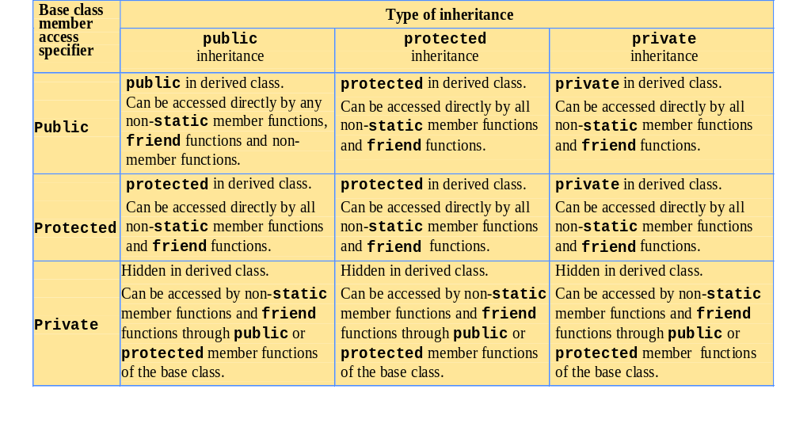
public, private, and protected

Slide 32
Base Classes
Direct base class
  Explicitly listed derived class’s header with the colon (:) notation when that derived class is declared
      class HourlyWorker : public Employee
    Employee is a direct base class of HourlyWorker
Indirect base class
  Not listed in derived class’s header
  Inherited from two or more levels up the class hierarchy
      class MinuteWorker : public HourlyWorker
    Employee is an indirect base class of MinuteWorker

Slide 33
Avoid Unnecessary Inheritance
Inheritance can be taken too far.
Good class libraries should be designed with:
  the minimum set of objects necessary to solve the problem, represent the domain, etc.
  a core set of unique base classes that are reusable through inheritance
  a depth of hierarchy that encourages application-specific branch derivations without exposing an excess of “dead end” interfaces and objects

Slide 34
Base Class Initializer
Base class initializer
  Uses member-initializer syntax
  Can be provided in the derived class constructor to call the base-class constructor explicitly
    Otherwise base class’s default constructor called implicitly
  Base-class constructors and base-class assignment operators are not inherited by derived classes
    Derived-class constructors and assignment operators, however, can call base-class constructors and assignment operators

Slide 35
Exercise #4 – “OOLane’s Express”
Recall the Lane’s Express Delivery exercise from Lecture #2.
What are some of the base classes? Are they direct or indirect?
What are some examples of base class initializers used in this design?
Give an example of member function overriding used in this design.
Give an example of one class hierarchy that would demonstrate unnecessary inheritance.

Slide 36
Derived Class Con/Destructors
A derived-class constructor
  Calls the constructor for its base class first to initialize its base-class members
  If the derived-class constructor is omitted, its default constructor calls the base-class’ default constructor
Destructors are called in the reverse order of constructor calls
  So a derived-class destructor is called before its base-class destructor

Slide 37
1 // Fig. 9.7: point2.h
2 // Definition of class Point
3 #ifndef POINT2_H
4 #define POINT2_H
5
6 class Point {
7 public:
8 Point( int = 0, int = 0 ); // default constructor
9 ~Point(); // destructor
10 protected: // accessible by derived classes
11 int x, y; // x and y coordinates of Point
12 };
13
14 #endif
15 // Fig. 9.7: point2.cpp
16 // Member function definitions for class Point
17 #include <iostream>
18
19 using std::cout;
20 using std::endl;
21
22 #include "point2.h"
23
24 // Constructor for class Point
25 Point::Point( int a, int b )
26 {
27 x = a;
28 y = b;
29
30 cout << "Point constructor: "
31 << '[' << x << ", " << y << ']' << endl;
32 }

Slide 38
33
34 // Destructor for class Point
35 Point::~Point()
36 {
37 cout << "Point destructor: "
38 << '[' << x << ", " << y << ']' << endl;
39 }
40 // Fig. 9.7: circle2.h
41 // Definition of class Circle
42 #ifndef CIRCLE2_H
43 #define CIRCLE2_H
44
Circle inherits from Point.
45 #include "point2.h"
46
47 class Circle : public Point {
48 public:
49 // default constructor
50 Circle( double r = 0.0, int x = 0, int y = 0 );
51
52 ~Circle();
53 private:
54 double radius;
55 };
56
57 #endif

Slide 39
58 // Fig. 9.7: circle2.cpp
59 // Member function definitions for class Circle
60 #include <iostream>
61
62 using std::cout;
63 using std::endl;
64
65 #include "circle2.h"
66
67 // Constructor for Circle calls constructor for Point
68 Circle::Circle( double r, int a, int b )
69 : Point( a, b ) // call base-class constructor
Constructor for Circle calls constructor for Point, first. Uses member-initializer syntax.
70 {
71 radius = r; // should validate
72 cout << "Circle constructor: radius is "
73 << radius << " [" << x << ", " << y << ']' << endl;
74 }
75
76 // Destructor for class Circle
77 Circle::~Circle()
Destructor for Circle calls destructor for Point, last.
78 {
79 cout << "Circle destructor: radius is "
80 << radius << " [" << x << ", " << y << ']' << endl;
81 }

Slide 40
82 // Fig. 9.7: fig09_07.cpp
83 // Demonstrate when base-class and derived-class
84 // constructors and destructors are called.
85 #include <iostream>
86
87 using std::cout;
88 using std::endl;
89
90 #include "point2.h"
Object created inside a block destroyed once it leaves scope.
91 #include "circle2.h"
92
93 int main()
94 {
95 // Show constructor and destructor calls for Point
Remember that the Point constructor is called for Circle objects before the Circle constructor (inside to out).
96 {
Point constructor: [11, 22]
Point destructor: [11, 22]
97 Point p( 11, 22 );
98 }
Point constructor: [72, 29]
Circle constructor: radius is 4.5 [72, 29]
Point constructor: [5, 5]
Circle constructor: radius is 10 [5, 5]
99
100 cout << endl;
101 Circle circle1( 4.5, 72, 29 );
Point destructor called after Circle destructor (outside in).
102 cout << endl;
Circle destructor: radius is 10 [5, 5]
Point destructor: [5, 5]
Circle destructor: radius is 4.5 [72, 29]
Point destructor: [72, 29]
103 Circle circle2( 10, 5, 5 );
104 cout << endl;
105 return 0;
106 }

Slide 41
Point constructor: [11, 22]
Point destructor: [11, 22]
Point constructor: [72, 29]
Circle constructor: radius is 4.5 [72, 29]
Point constructor: [5, 5]
Circle constructor: radius is 10 [5, 5]
Circle destructor: radius is 10 [5, 5]
Point destructor: [5, 5]
Circle destructor: radius is 4.5 [72, 29]
Point destructor: [72, 29]

Slide 42
Derived vs. Base Class
Assignment of derived and base classes
  Derived-class type and base-class type are different
  Derived-class object can be treated as a base-class object
    Derived class has members corresponding to all of the base class’s members
    Derived-class has more members than the base-class object
    Base-class can be assigned a derived-class
  Base-class object cannot be treated as a derived-class object
    Would leave additional derived class members undefined
    Derived-class cannot be assigned a base-class
    Assignment operator can be overloaded to allow such an assignment

Slide 43
Derived vs. Base Class
Mixing base and derived class pointers and objects
  Referring to a base-class object with a base-class pointer
    Allowed
  Referring to a derived-class object with a derived-class pointer
    Allowed
  Referring to a derived-class object with a base-class pointer
    Possible syntax error
    Code can only refer to base-class members, or syntax error
  Referring to a base-class object with a derived-class pointer
    Syntax error
    The derived-class pointer must first be cast to a base-class pointer

Slide 44
Software Engineering
Classes are often closely related
  “Factor out” common attributes and behaviors and place these in a base class
  Use inheritance to form derived classes
Modifications to a base class
  Derived classes do not change as long as the public and protected interfaces are the same
  Derived classes may need to be recompiled

Slide 45
Composition vs. Inheritance
“Is a” relationships
  Inheritance
    Relationship in which a class is derived from another class
“Has a” relationships
  Composition
    Relationship in which a class contains other classes as members

Slide 46
“Uses A” vs. “Knows A”
“Uses a”
  One object issues a function call to a member function of another object
“Knows a”
  One object is aware of another
    Contains a pointer or handle to another object
  Also called an association

Slide 47
Exercise #5 – “Not So Hardware - Revisited”
Recall the exercise from Lecture #2.
If we expand the system beyond CHammer, CNail, CSaw, and CWood to include a CStorage base class and derived objects CToolbox and CToolbelt, how can one describe the system in terms of:
  “Is a” – Inheritance
  “Has a” – Composition
  “Uses a” – Object 1 calls Object2::function()
  “Knows a” – Object 1 contains pObject2

Slide 48
-Break-

Slide 49
Exercise #6 – “Muzix”
A new music swapping system, Muzix, will use an object-oriented database (MOOD) to manage (a) free, 30 second (teaser) cuts and (b) secure, for-pay, complete songs. Use independent headers for the song information base class (CSongInfo) and the derived classes CPromoSongInfo and CSecureSongInfo. Use private data and public set/get member functions. Choose appropriate defaults in your Constructors.
The base class should include song title, album title, name of artist, file size, whether the song is streamable, downloadable, or both, and the date of entry to the MOOD system.
CPromoSongInfo should include the price of the full song, the Muzix Store web link (to buy the song), and the number of days remaining in the promotion.
CSecureSongInfo should include song duration, an encryption type (enum: SECURE_1, SECURE_2, or SECURE_3), and a unique product identifier.
How might we implement this system?

Slide 50
Assignment

Slide 51
Assignment #2 – Part I
Create a CMoodMgr class that allows a user to:
Input MOOD data from the command line.
Edit MOOD data from the command line.
Read MOOD data from a MOOD data file.
Write MOOD data to a MOOD data file.
Sort data by Artist, Song Title, or Song Duration.
Notes: Everyone will have a different MOOD data file format. That’s expected.

Slide 52
Assignment #2 – Part I
Implement reasonable error checking.
Use OOP techniques. Classes must include: CMoodMgr, CSongInfo, CPromoSongInfo, CSecureSongInfo. Use one header and one source file per class. Zip your files prior to emailing.
Your solution must compile, link, and function properly.
Each source code file for an assignment MUST include a comment block at the top containing your name, class number (CST 136), and the assignment number.

Slide 53
Assignment #2 – Part I
Assignment #2 (Part I and Part II) is to be emailed to virgilid@oit.edu by noon on April 28. Late assignments will not be accepted.
Part II will be assigned during next Monday’s lecture.

